Slide 1

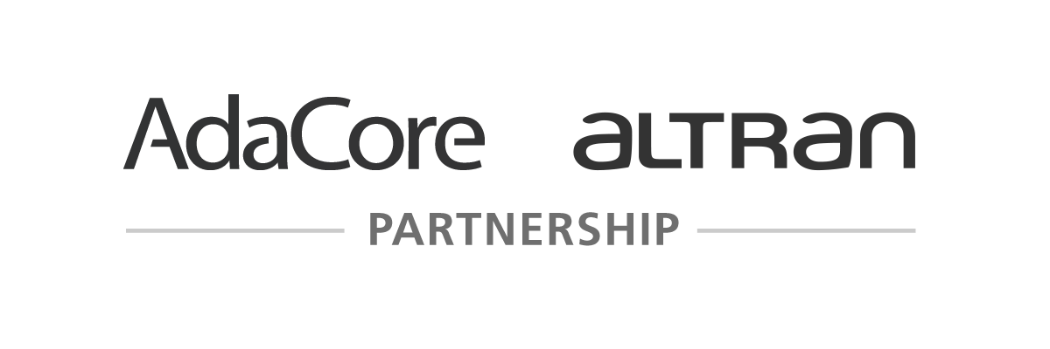
Boundaries of Formal Program Verification
Yannick Moy – AdaCore

Slide 2
SPARK – the language
strong typing
low level programming
generics
object orientation
concurrency
Abstract_State
Initializes
Initial_Condition
Contract_Cases
Global
Depends
pointers
exception handlers
controlled types
function with effects
Ada
features outside
the SPARK subset
Core language constructs common to Ada and SPARK
Additional SPARK aspects
Ada
SPARK

Slide 3
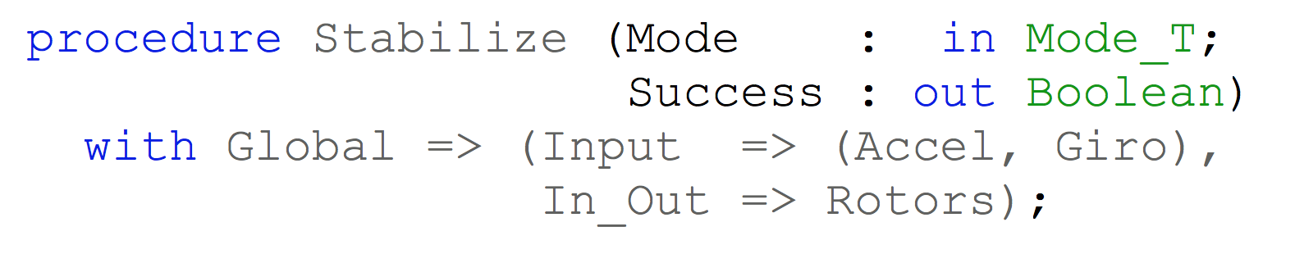
SPARK – flow analysis
Specification of effects
Flow analysis
Program implements specification

Slide 4
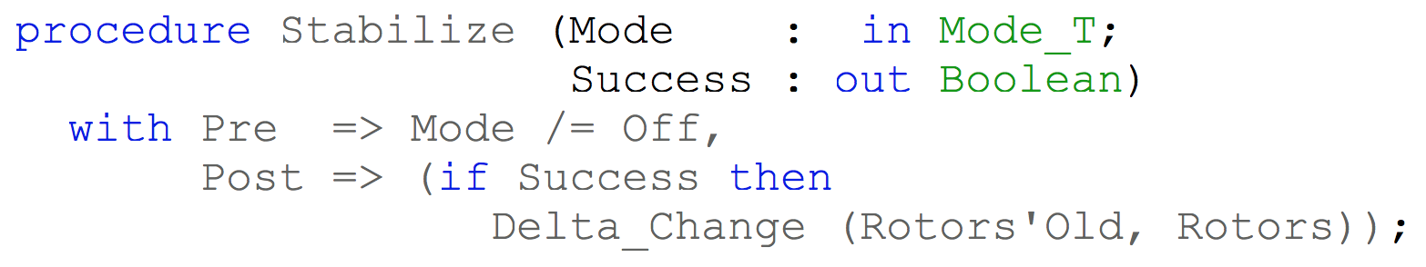
SPARK – proof
Specification of properties
Proof
Program implements specification

Slide 5
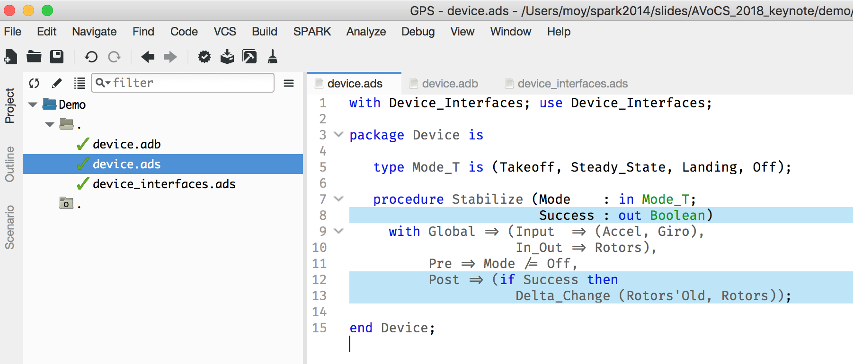
SPARK – demo

Slide 6
Bounding the language
Previous SPARK based on its own grammar subset of Ada
many restrictions on program structure, control flow, language features
very hard to show value to new users before commitment!
David A. Wheeler: “Be a good date; commitment happens later”
Now only exclude features that make formal analysis impossible: catching exceptions, using pointers (but ownership pointers on the way)

Slide 7
Bounding the program
Previous SPARK based on opt-out only (with annotation #hide)
Need for shadow (spec) files at boundaries (libraries, hardware, OS)
Not adapted to retrospective analysis
Now a mix of opt-in, opt-out and opt-auto (for included specs)
Choice of boundary at top-level for mixing unit-level test & proof
→ Choice is questioned by some users requiring more flexibility

Slide 8
Code-level specifications and beyond
Previous SPARK based on logical specifications only (#pre, #post)
Now based on executable specifications by default (with escape hatch):
preconditions, postconditions on subprograms
predicates, invariants on types
Looking at expanding the specification towards design models:
data-flow programs in Simulink
design models in VDM, AADL+AGREE, SysML+SpeAR

Slide 9
Analysis at function level and beyond
Previous SPARK: only function-level analysis (dataflow analysis or proof)
Requires too much specification effort
Current SPARK: mostly function-level analysis, but…
Read/write effects are generated if needed
Instances of generics (templates) are separately analyzed
Read/write concurrent accesses are analyzed globally
Subprograms may be inlined, loops may be unrolled…

Slide 10

Bounding the expertise
From the start, SPARK aimed at “good engineering”
Peter Amey, foreword of “High Integrity Software – the SPARK Approach to Safety and Security”, 2002:
“The migration of static analysis from a painful, post-hoc verification exercise to an integral part of a sound development process is now well-established.”
Most companies still found the expertise required too high

Slide 11
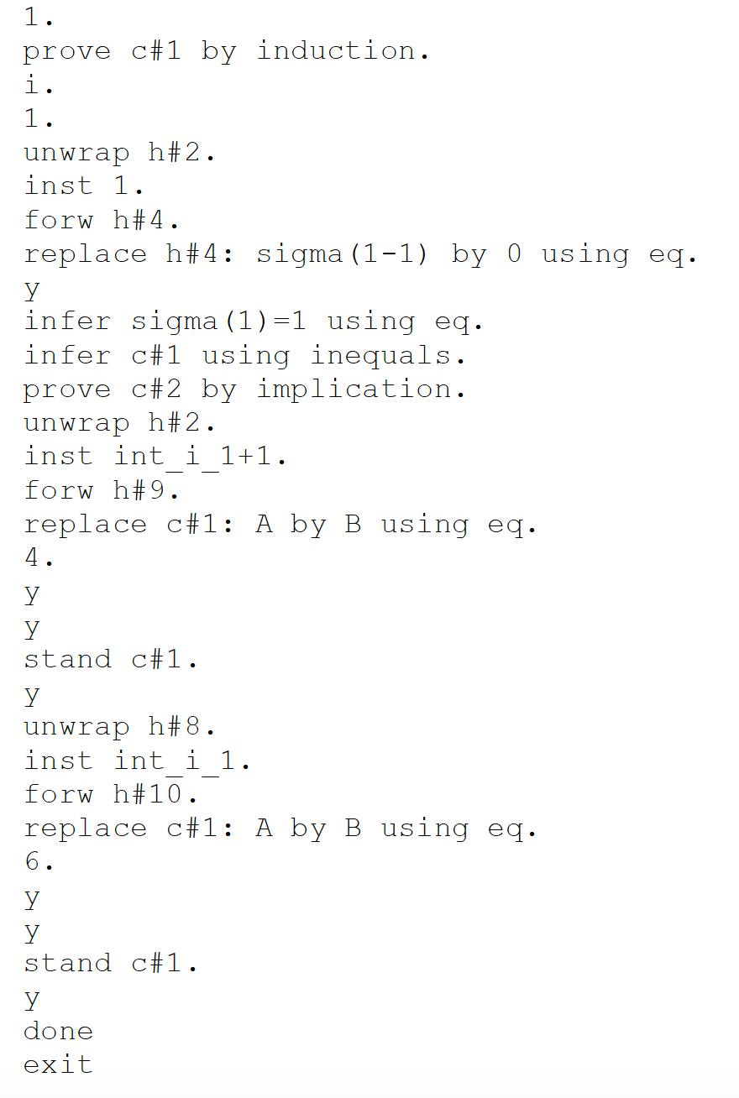
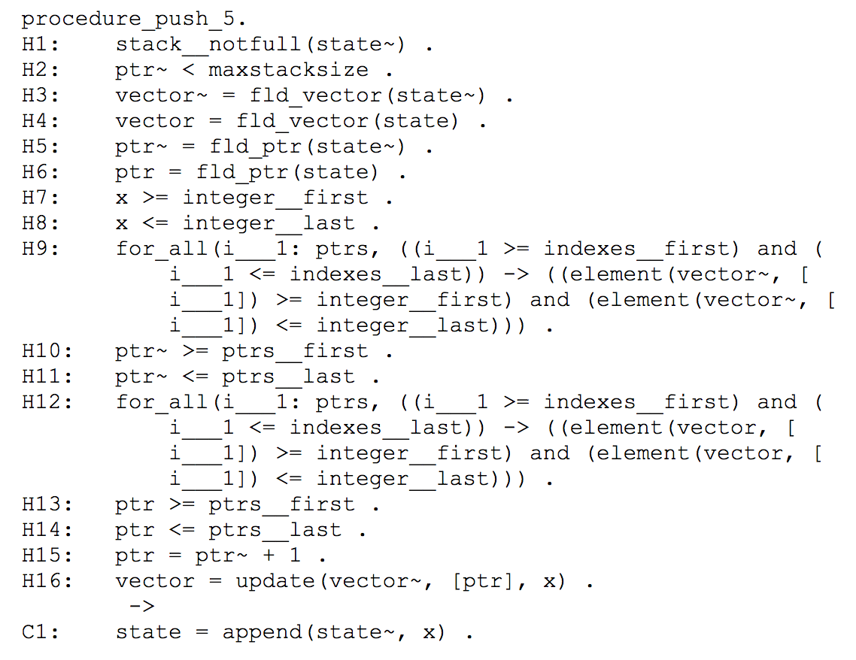
Example of required expertise: manual proof
Verification Condition
in SPARK 2005
Manual Proof
in SPARK 2005

Slide 12
Bounding the expertise
Critical change in new SPARK: specification is code
same semantics in code and specification
same tools to operate on specification: IDE, compiler, debugger, test
users never look at Verification Conditions
Tool support is most needed to help users with:
modularity – counterexamples, safety guards, smoke detectors
induction – loop invariant generation, loop unrolling, loop patterns
undecidability – guidance on how to address unproved properties

Slide 13
From tour-de-force to run-of-the-mill
Example: Skein cryptographic hash algorithm in SPARK (Chapman, 2011)
initial version (SPARK 2005) | current version (SPARK 2014)
41 non-trivial contracts for effects and dependencies | 1 – effects and dependencies are generated
31 conditions in preconditions and postconditions on internal subprograms | 0 – internal subprograms are inlined
43 conditions in loop invariants | 1 – loop frame conditions are generated
24 cuts to avoid combinatorial explosion | 0 – no combinatorial explosion
22 hint assertions to drive proof | 0 – no need
23 manual proofs | 0 – no need

Slide 14
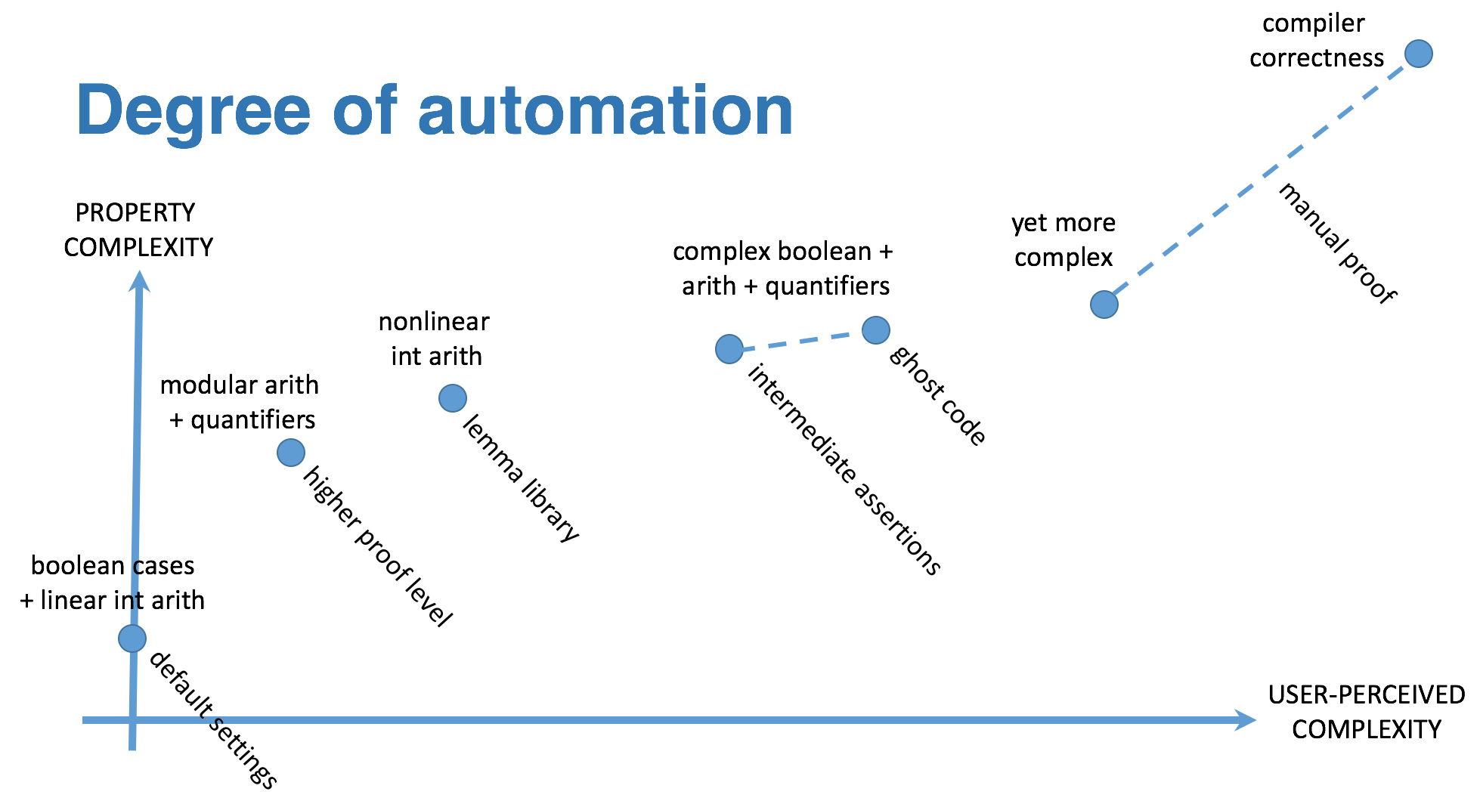
Building the expertise

Slide 15
Bounding the effort

Slide 16
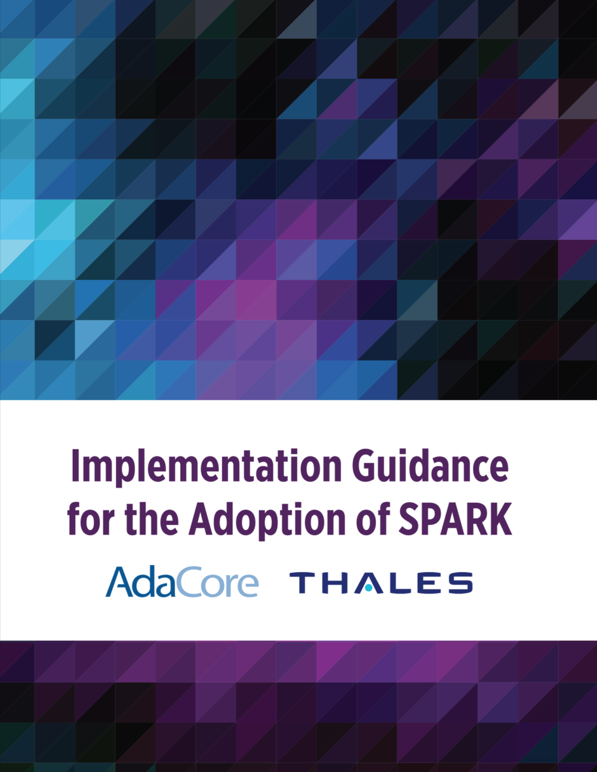
Expanding to application on legacy software
Traditional SPARK development known as “Correct-by-Construction”
Not possible to “sparkify” existing codebases
Not applicable to legacy codebases
David A. Wheeler: “If a system works, it’s a legacy system”
Moving towards application to legacy codebases
→ Levels of assurance are critical to support progressive adoption

Slide 17
Expanding the user base
Traditional SPARK customers: military, avionics, space, security
More recent applications to medical device, automotive, autonomous vehicles
All in the context of industrial R&D projects / POC
Still need for general awareness, education, case studies, etc.
Example of successful spreading: seL4 highly visible success ➔ Muen separation kernel in SPARK ➔ SPARK kernels at ANSSI, ETH Zurich, etc.

